Slide 1
MICRO CREDIT LOAN USE CASE
-AKASH PANDEY

Slide 2

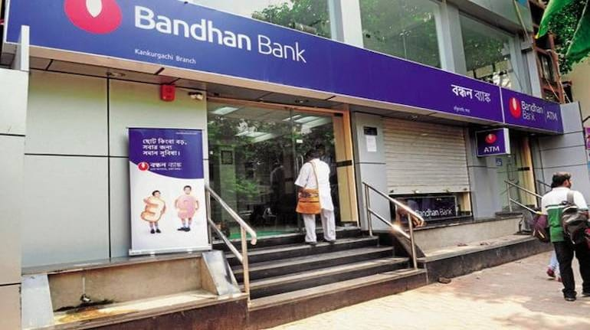
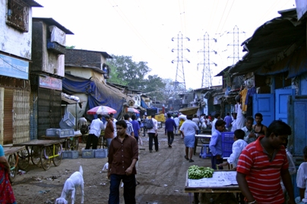
Telecom industry
Microfinance Institution (MFI)
credit
Loan payback
payment
Mobile recharge
Low income group

Slide 3
business task the project address
A model to better predict the default among next debtors, thereby selecting the best debtors
Analysing the customers with least default
Linkage of loan takers and recharges

Slide 4
Model built
predicts the probability for each loan transaction
whether the customer will be paying back the loaned amount within 5 days of insurance of loan
Label ‘1’ indicates that the loan has been payed i.e. Nondefaulter
while, Label ‘0’ indicates that the loan has not been payed i.e. defaulter.

Slide 5
Modelling technique used
Statistical data analysis
Exploratory data analysis
Graphical data analysis
Feature Engineering
Feature Selection
Data was split into train and test data

Slide 6
Modelling was tried on 4 classification techniques
 | Logistic regression model | DecisionTreeClassifier model | RandomForest Classifier | SVC
Accuracy score | 78 | 80 | 85 | 81
Cross validation score | 74.98 | 79.84 | 85.14 | 76.19
roc_auc_score | 76.53 | 7996 | 85.32 | 78.42

Slide 7

Hyper Parameter Tuning
Model saving

Slide 8
Accuracy of model
Accuracy score | 85.94
ROC AUC Score | 85.15
Cross validation score | 85.18
Recall score | 84.98
Precision score | 85.49

Slide 9

Monetary Benfits from the model
Focus on parameters on customers who rarely defaults
Charge higher interest rate on those who might default
Improve Marketing towards customers who have good payment history

Slide 10
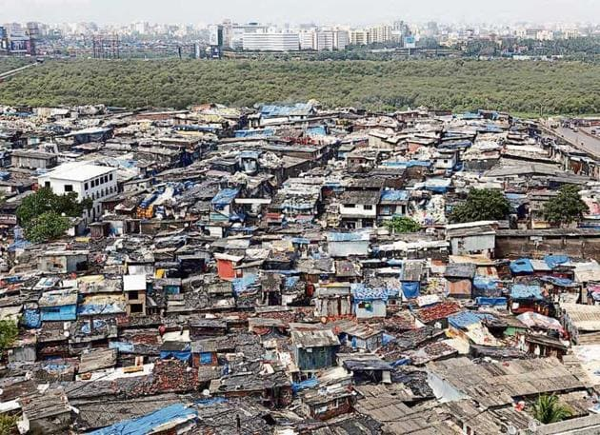
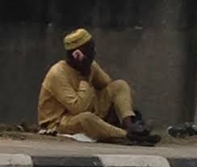
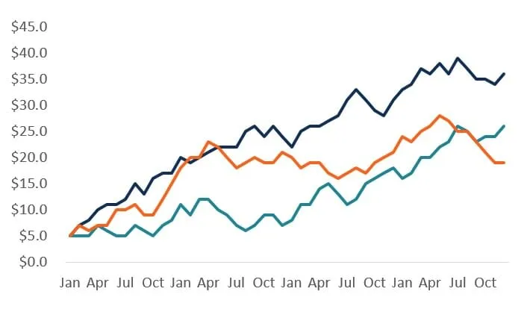
VISUALIZATION OF OUR CUSTOMER DETAILS

Slide 11
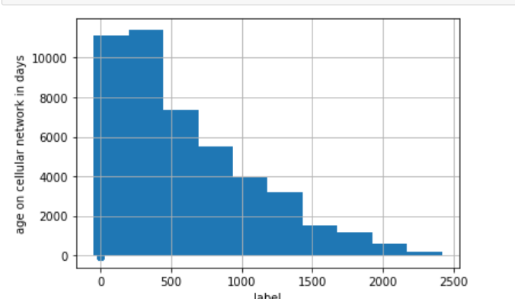
age on cellular network in days
Ages on the celllar network varies between 0 to 2400 days

Slide 12
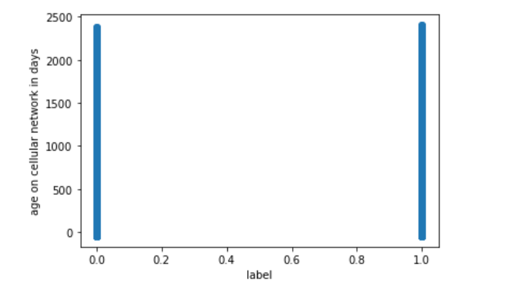
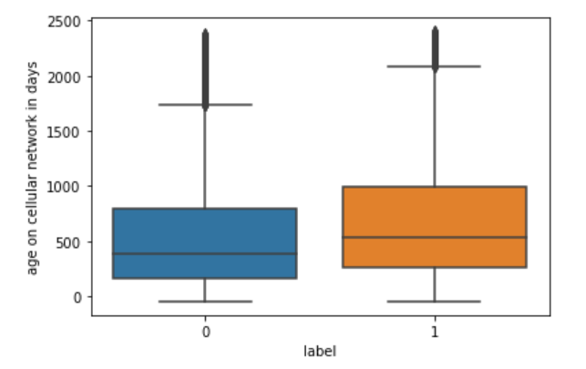
The default has been seen
1.Median is 480days
2.Minium is 0days
3.Maximum is 1750days

Slide 13

30 days and 90 days will be taken into consideration
A person can recharge two accounts
Main account recharge
Data account recharge

Slide 14
Main Account
Daily amount spent from main account, averaged over last 30 days
Number of times recharge done in last 30
Total amount of recharge in main account over last 30 days
Median of main account balance just before recharge in last 30 days at user level
Mean of main account balance over last 30 days
Median of amount of recharges done in main account over last 30 days at user level

Slide 15

For Last 30days

Slide 16
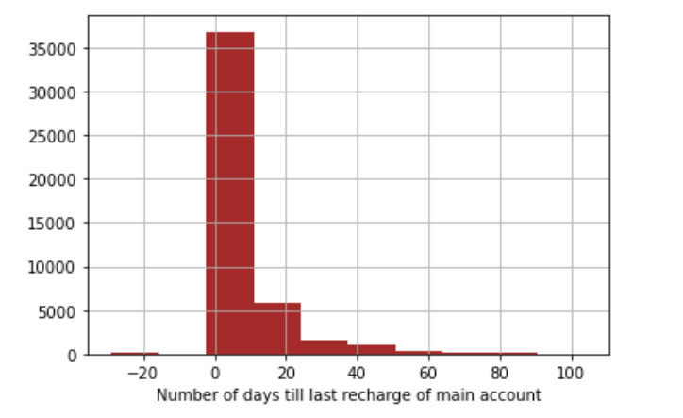
Number of days till last recharge of main account
Most of them recharged within last 10days of taking the sample

Slide 17
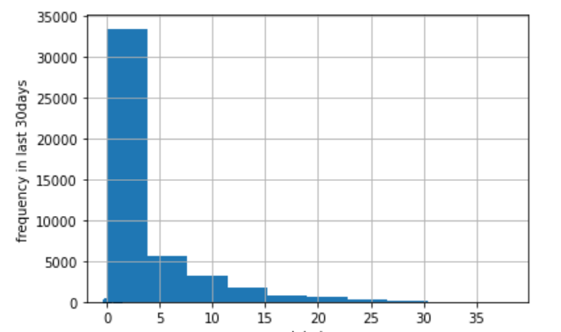
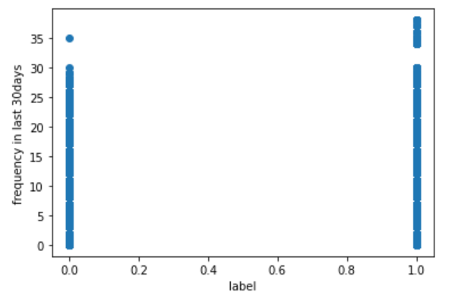
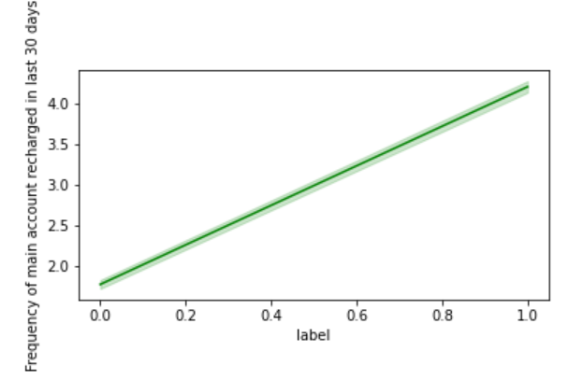
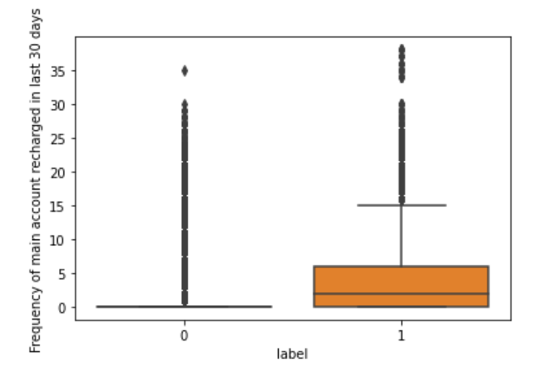
Number of times recharge done in last 30
1.Maximum times recharge was done was between 1 and 4
2.Default is less if the number of recharge is above 30
i.e a person with more recharging potential will not default much

Slide 18
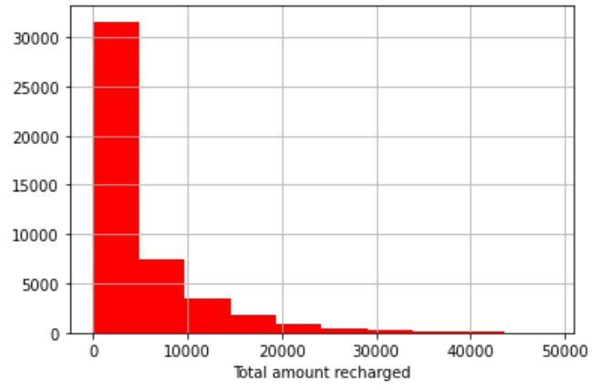
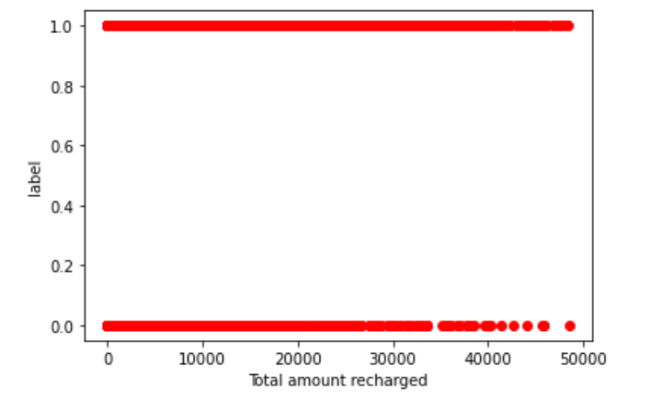
Total amount recharged
The total amount recharged is maximum between 1 and 9500
The people who have recharged above 30,000 have defaulted less

Slide 19
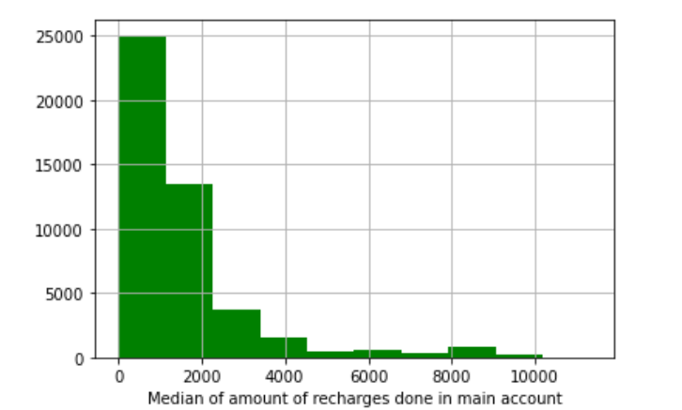
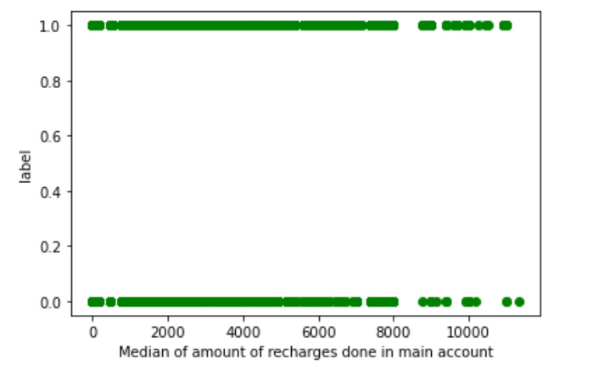
Median of amount of recharges done in main account
Median of amount of recharge is maximum between 0 and 1000
The median of amount of recharge is not much dependent on the label

Slide 20
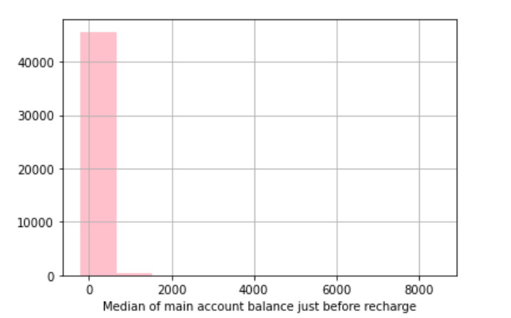
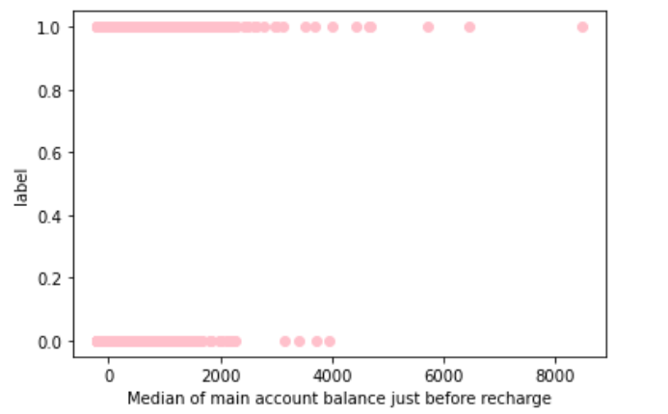
Median of main account balance just before recharge
The maximum account balance median before recharge was between 0 and 700
Median of balance before recharge when it was above 2500, there was lesser chances to default

Slide 21

For Last 90days

Slide 22
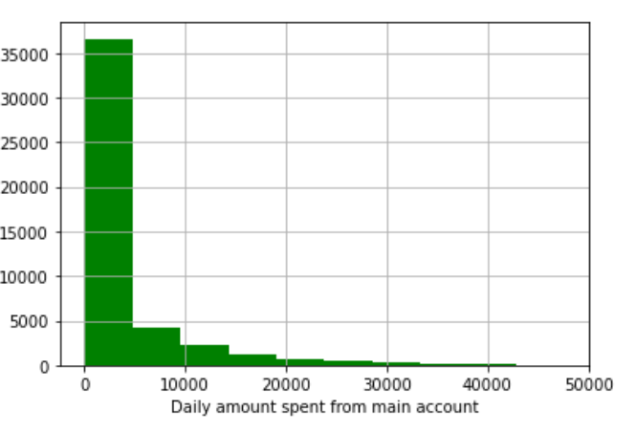
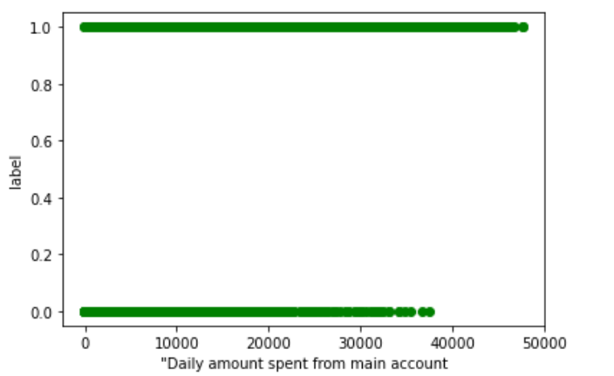
Daily amount spent from main account
Maximum daily spent in last 90 days is between 0 and 5000
The default rate is lower when the person uses daily amount above 39,000

Slide 23
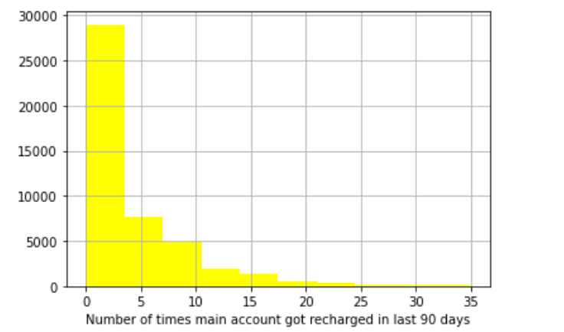
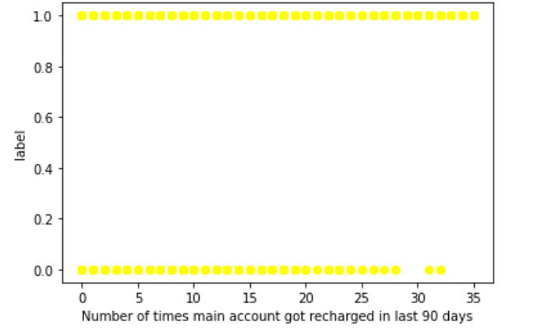
Number of times main account got recharged in last 90 days
Maximum number of times is between 1 and 4
Above 28 times, the default rate is less

Slide 24
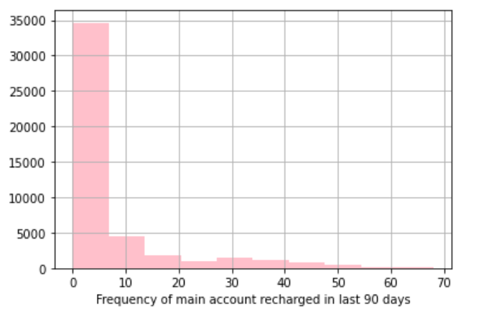
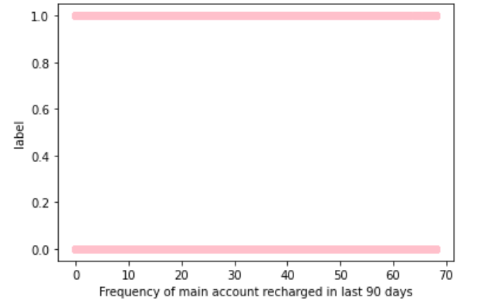
Frequency of main account recharged in last 90 days
Frequency does not impact the label

Slide 25
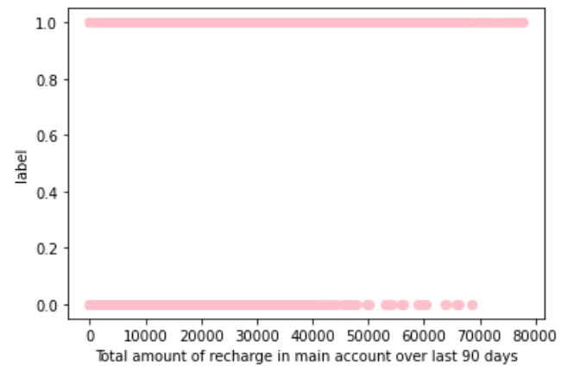
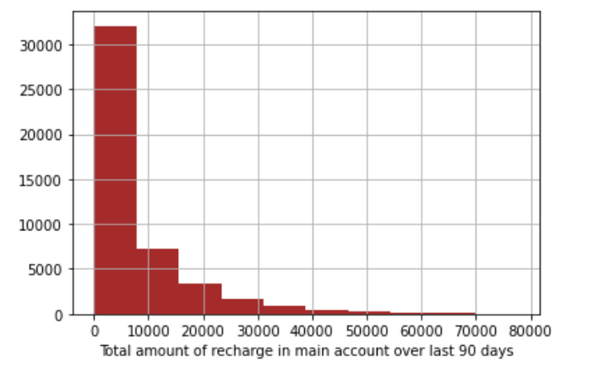
Total amount of recharge in main account over last 90 days
Total amount of recharge is maximum upto 9,000
The default rate decreases for the customers who recharged their main account in last 90 days above 50,000

Slide 26
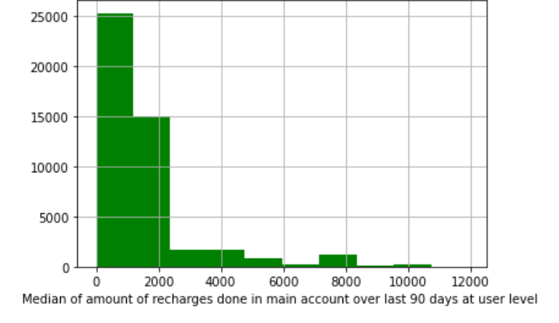
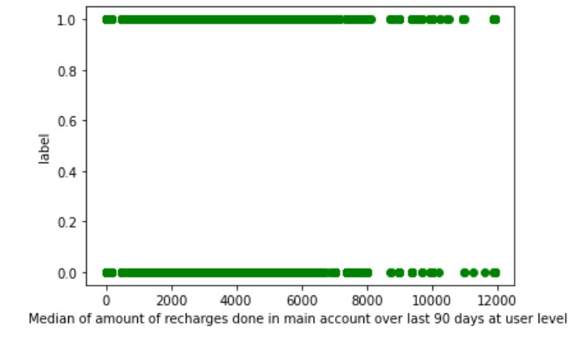
Median of amount of recharges done in main account over last 90 days at user level

Slide 27
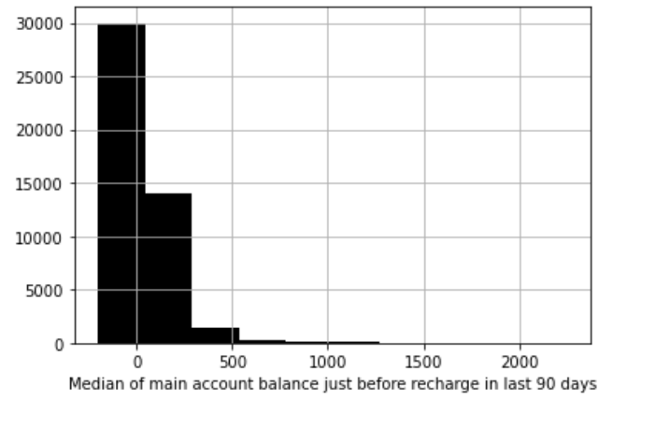
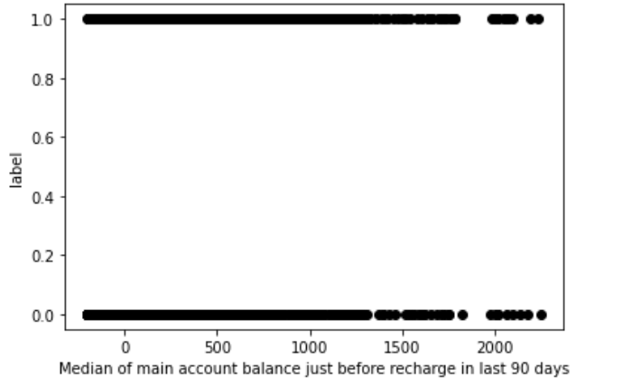
Median of main account balance just before recharge in last 90 days

Slide 28

DATA ACCOUNT

Slide 29
Data account recharged will be analysed for
30 days
90 days

Slide 30
For Last 30days
Data account

Slide 31
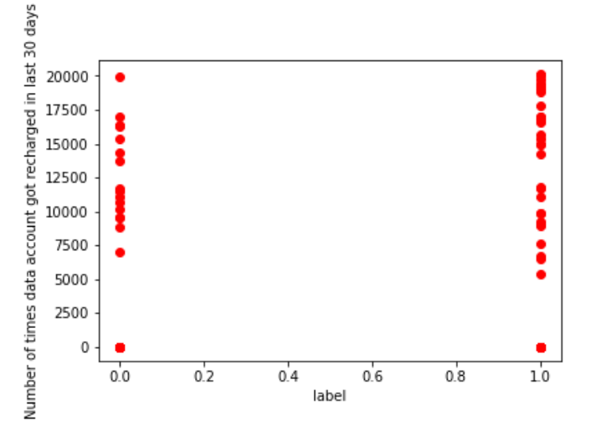
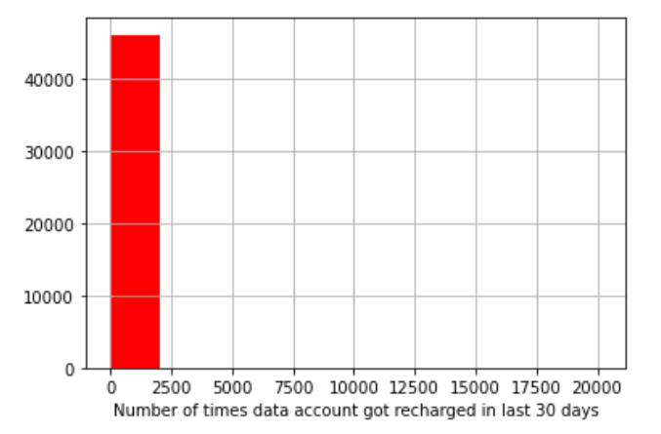
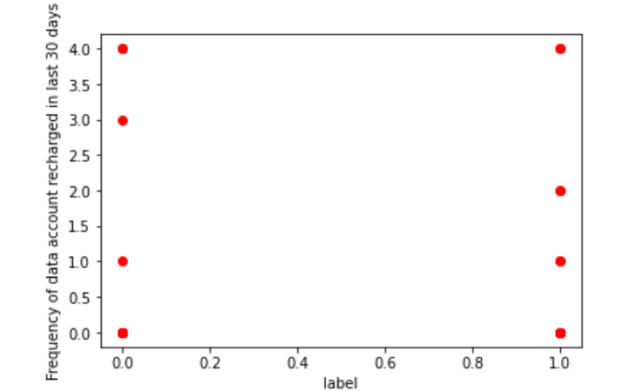
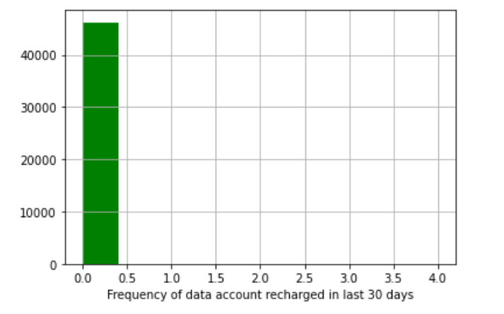
Number of times data account got recharged in last 30 days
The people who had recharged the data account between 7,500 and 17500 have shown defaulting

Slide 32
For Last 90days

Slide 33
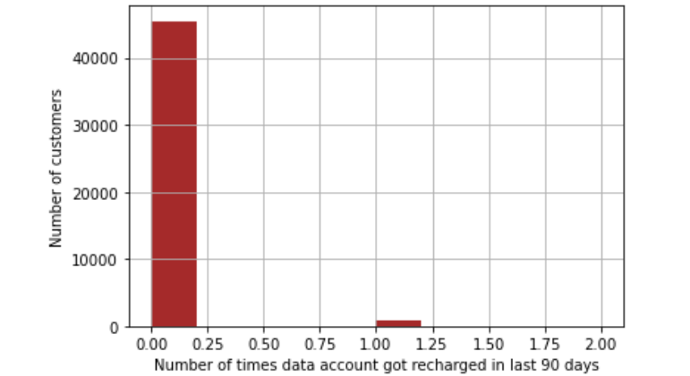
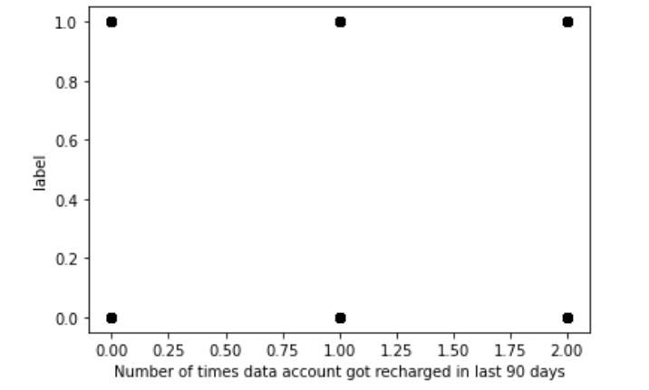
Number of times data account got recharged in last 90 days
Number of times is 40,000 and there is no impact on the label

Slide 34


loan amount of 5
payback amount should be 6
loan amount of 10
payback amount should be 12
MFI bank

Slide 35
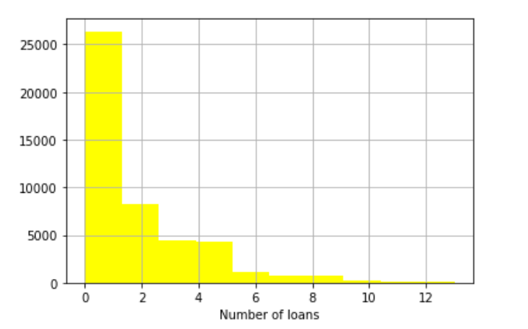
Number of loans taken by user in last 30 days
Between 0 and 2

Slide 36
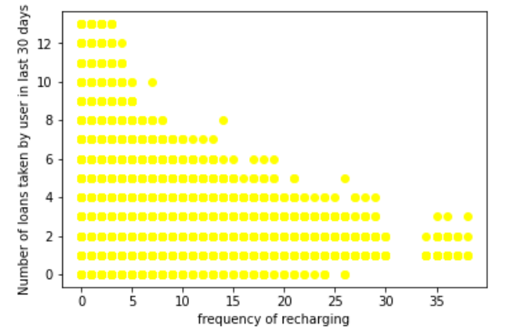
 | Number of loans taken | Frequency of recharge
 | 1 | 0 to 24
 | 2 | 0 to 30
 | 3 | 0 to 29
 | 4 | 0 to 29
 | 5 | 0 to 20
 | 6 | 0 to 20
 | 7 | 0 to 14
 | 8 | 0 to 9
 | 9 | 0 to 6
 | 10 | 0 to 6
 | 11 | 0 to 5
 | 12 | 0 to 5
It can be seen the higher the loan taken,
The frequency of recharge is less

Slide 37
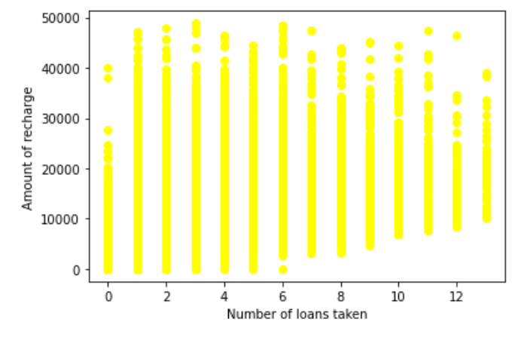
People who have taken loans 2 times,3 times and 6 times are seen to recharge with maximum amounts

Slide 38
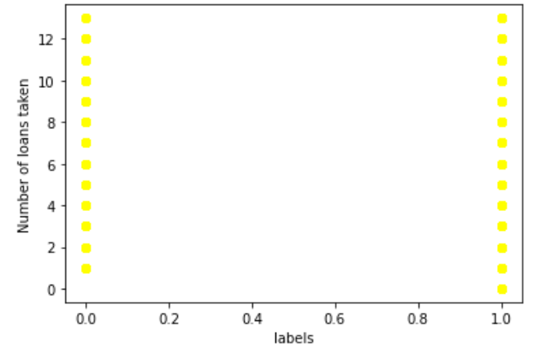
The number of loans taken does not impact the Defaulting much

Slide 39
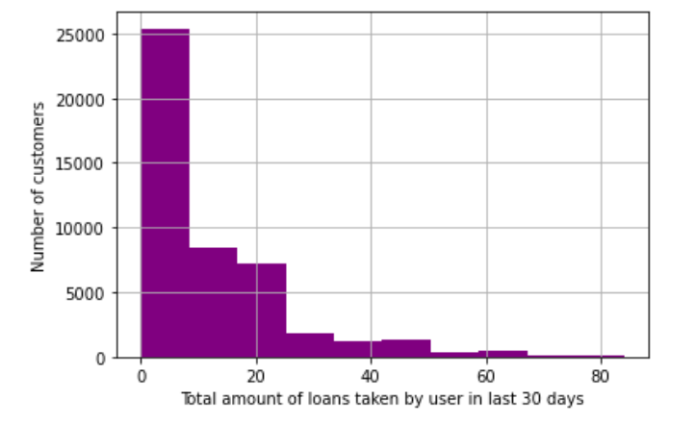
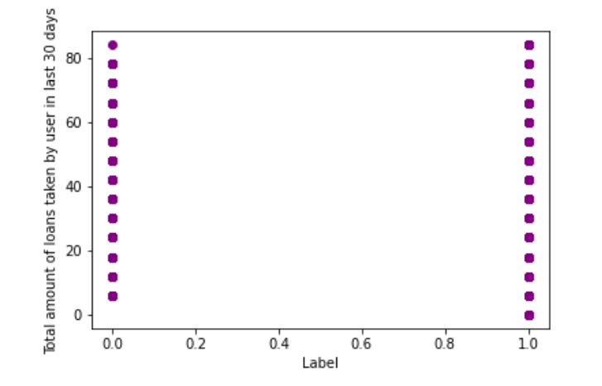
Amount of loan taken
The total amount of loans taken has been between 0 and 7
The amount of loan taken and default rate has not much interdependence

Slide 40
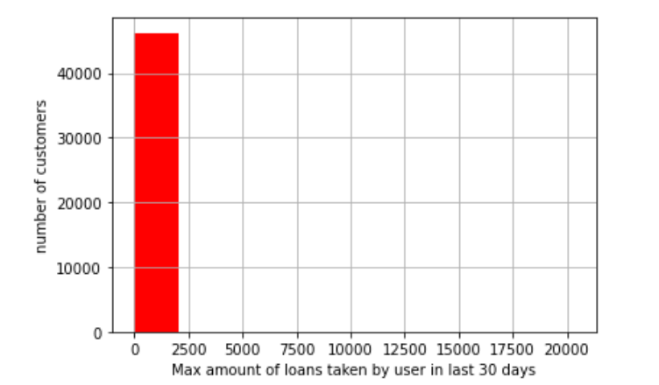
maximum amount of loan taken by the user in last 30 days
There are only two options: 5 & 10 Rs., for which the user needs to pay back 6 & 12 Rs. respectively
The highest loan amounts are upto 2,400

Slide 41
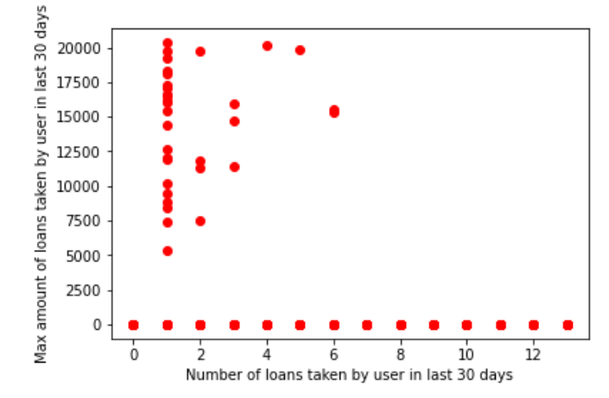
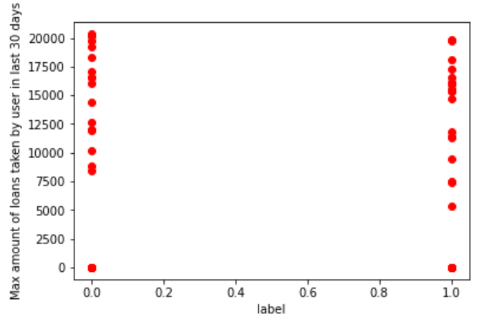
Default rate is higher when max loan taken is above 17500
Maximum amount of loans are when number of loan taken is 1

Slide 42
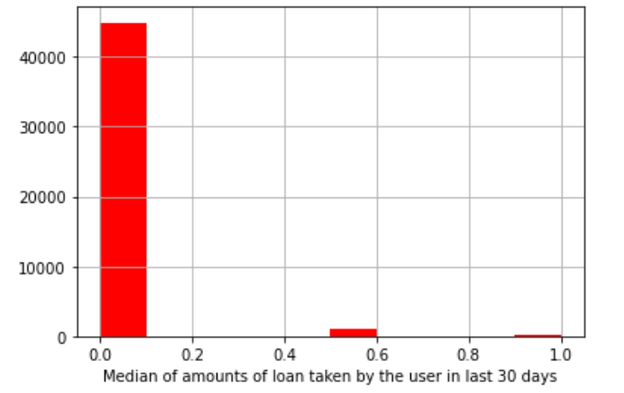
Median of amounts of loan taken by the user in last 30 days
Median is within 0.1

Slide 43
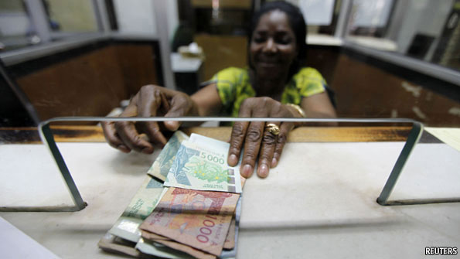
Mean payback time

Slide 44
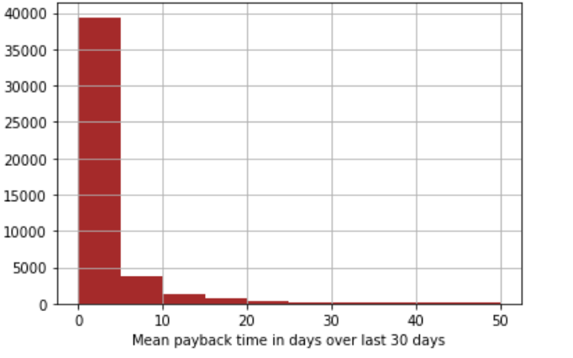
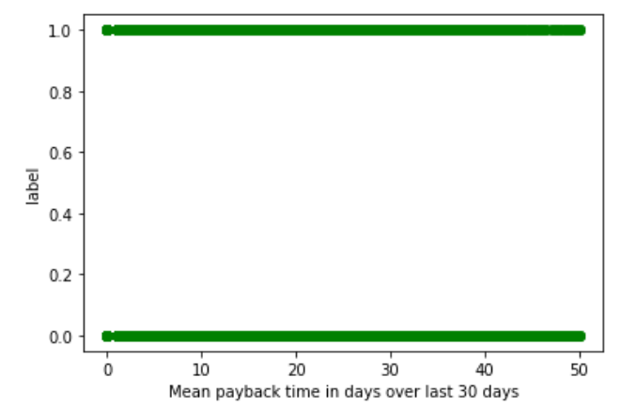
For 30days
Mean payback varies between 1 and 9
It does not impact the labels

Slide 45


For 90 days
Mean payback is inside 7days mostly
It does not impact the label

Slide 46
Chance of defaulting
Main account recharge
Data account recharge
Loan taken
Age
1.Frequency of recharge
2.Amount of recharge
1.Frequency of recharge
2.Amount of recharge
Frequency of loan
2.Amount of loan

Slide 47
Thankyou. Have a great day ahead.

